Slide 1
MSH Drug Seller Initiatives
Presented by Martha Embrey
September 25, 2018

Slide 2

ADDOs in Tanzania—the Foundation
Many people access medicines and services from drug shops, but quality is an issue
Working with Tanzanian stakeholders, MSH launched the accredited drug seller outlet (ADDO) program in 2003
Countrywide scale up achieved by 2013; now part of the health system
Initial funding from the Gates Foundation with other contributors to scale up over the years; now operates without donor support
Currently, ~12,500 accredited shops, 3,500+ government inspectors trained, 20,000+ dispensers trained, 8 approved training institutions
Notes:
Billboard advertising “Duka la Dawa Muhimu” or “Essential Drug Shop”

Slide 3
What have we learned from ADDOs?
Drug seller initiatives based on accreditation and regulation can improve access to quality services and medicines
Medicine shops serve as a platform to scale up other community-based public health interventions, such as family planning
Political will (medicines regulatory authority) and stakeholder engagement are critical to sustainability
Decentralization and district-level implementation are key to successful country-wide scale-up of any drug seller initiative
External funding required for scale-up, but then program can be self-sufficient—owners/dispensers and government
Holistic rather than product- or condition-specific approach produces success and sustainability

Slide 4
How we do it
Gain broad-based support from all stakeholders
National (medicines regulatory authority or pharmacy council) and local authorities, professional associations
Develop requirements and build stewardship and governance capacity
Work with regulatory authority on accreditation standards
Build private sector capacity
Provide incentives
Participatory approach to project design and implementation
Decentralized inspection strategy; central oversight
Business skills of owners
Case management and communication skills of dispensers
Ability to sell expanded range of medicines and other commodities legally, including prescription medicines
Loans
Mobile technology applications (e.g., mobile money)
Products in stock, approved, and registered by the regulatory authority; local suppliers
Mentoring and supervision
Record keeping
Holistic approach not driven by one product or condition
Training institutions for sustainability
Notes:
Including data from drug shops in HMIS
Technical skills for DMPA for example?

Slide 5
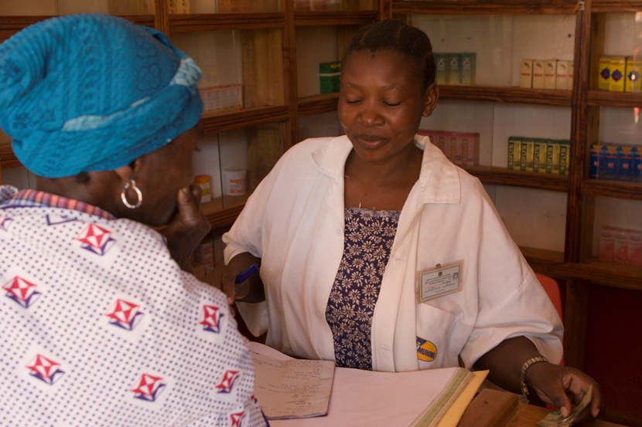
LaunchDSI Program (2015-2019)
Objective: advance the adaptation of accredited drug seller initiatives (ADSI) in other African countries
Fourth in a series of Gates grants for ADSI work
Approach—
  Provide small start-up grants to countries demonstrating interest in establishing an ADSI
  Fund stakeholder learning visits to Tanzania
  Provide technical assistance to help create ADSI model
  Help mobilize funding for implementation and scale-up
  Support Tanzania’s Pharmacy Council with ADDO institutionalization

Slide 6
Progress under LaunchDSI
Country | TZ visit | Sub grant | Status
Burundi | ■ |  | Completing an expression of interest to receive a subgrant and additional technical assistance for mapping and stakeholder meeting
DRC | ■ |  | As a first step, wants to map shops in Kinshasa; delays due to Ebola
Ghana | ■ |  | Completing an expression of interest to receive a subgrant and additional technical assistance for mapping and stakeholder meeting
Liberia* | ■ | ■ | Accreditation implemented in four counties under LaunchDSI (five total); 1000+ dispensers trained; looking for funding to continue scale-up
Mozambique |  |  | Expressed interest in participating in TZ learning visit
Nigeria | ■ | ■ | Extensive stakeholder engagement; standards for three tiers of PPMVs with relevant training agendas under review
Sierra Leone | ■ |  | Completing an expression of interest to receive a subgrant and additional technical assistance for mapping and stakeholder meeting
Uganda* | ■ | ■ | ~1000 shops accredited in 13 districts (4 under LaunchDSI)
Zambia | ■ | ■ | National steering committee, standards and curriculum finalized, stakeholder sensitization and mapping, inspectors trained
Notes:
* Subgrants have ended

Slide 7
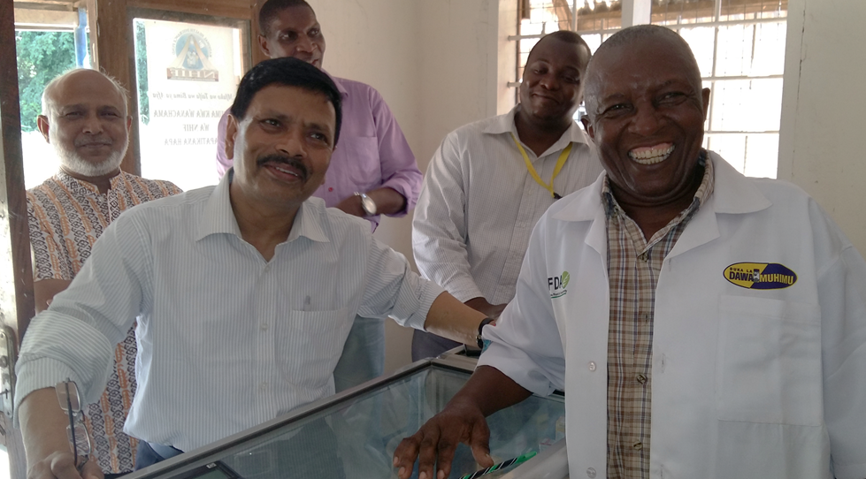
Accredited drug shops in Bangladesh
  Initial work funded by Joint Donor Technical Assistance Pool (primarily DFID; 2015-2016)
Progress to date—
  First ever retail drug outlet standards adopted in Bangladesh for Level 1 pharmacies and Level II drug shops
  Accreditation model and limited piloting completed in 2016-2017
  New DFID funding received to accredit 5,000 shops in 18 months
Bangladesh delegation makes accredited drug outlet learning visit to Tanzania

Slide 8
Drug shops as a platform for public health
DMPA-SC in Uganda¹
Antimicrobial resistance sensitization (TZ)²
Formalized referral links among ADDOs, CHWs, and health facilities (TZ)³
TB case-finding (TZ) ⁴
RDTs and appropriate dispensing in Uganda⁵
Government-subsidized ACTs in Tanzania⁶
¹ Akol et al. 2014. Getting closer to people: family planning provision by drug shops in Uganda. Glob Health Sci Pract 2(4)
² Valimba et al. 2014. Engaging the private sector to improve antimicrobial use in the community: experience from accredited drug dispensing outlets in Tanzania. Journal of Pharmaceutical Policy and Practice 7(11)
³ Dillip et al. 2017. Can formalizing links among community health workers, accredited drug dispensing outlet dispensers, and health facility staff increase their collaboration to improve prompt access to maternal and child care? A qualitative study in Tanzania. BMC Health Serv Res.19;17(1)
⁴ Rutta et a. 2014. Understanding private retail drug outlet dispenser knowledge and practices in tuberculosis care in Tanzania. Int J Tuberc Lung Dis 2014 18(9)
⁵ Mbonye et al. 2015. A Cluster Randomised Trial Introducing Rapid Diagnostic Tests into Registered Drug Shops in Uganda: Impact on Appropriate Treatment of Malaria. PLoS ONE 10(7)
⁶ Rutta et al. 2011. Increasing Access to Subsidized Artemisinin-based Combination Therapy through Accredited Drug Dispensing Outlets in Tanzania. Health Research Policy and Systems 9(22)

Slide 9
Challenges
Concept acceptance and implementation requires commitment (strong government champion—regulatory authority), change in law/regulation, time, money; we can provide assistance, but the decisions are not ours
Country conceptualization and nationwide scale-up are expensive and time consuming
  Most donors cautious about start-up funding or will not fund multiyear scale-ups of the magnitude needed (Global Fund in Tanzania was exception)
  Piece-meal funding of an initiative involves risks, including inefficiencies and failures; coordination is critical
  A harmonized accreditation framework helps advance initiatives, but finding the resources to scale up pilots takes time
Sustainable oversight and maintenance (e.g., continuing education) requires dedicated country resources, which is difficult with competing priorities

Slide 10
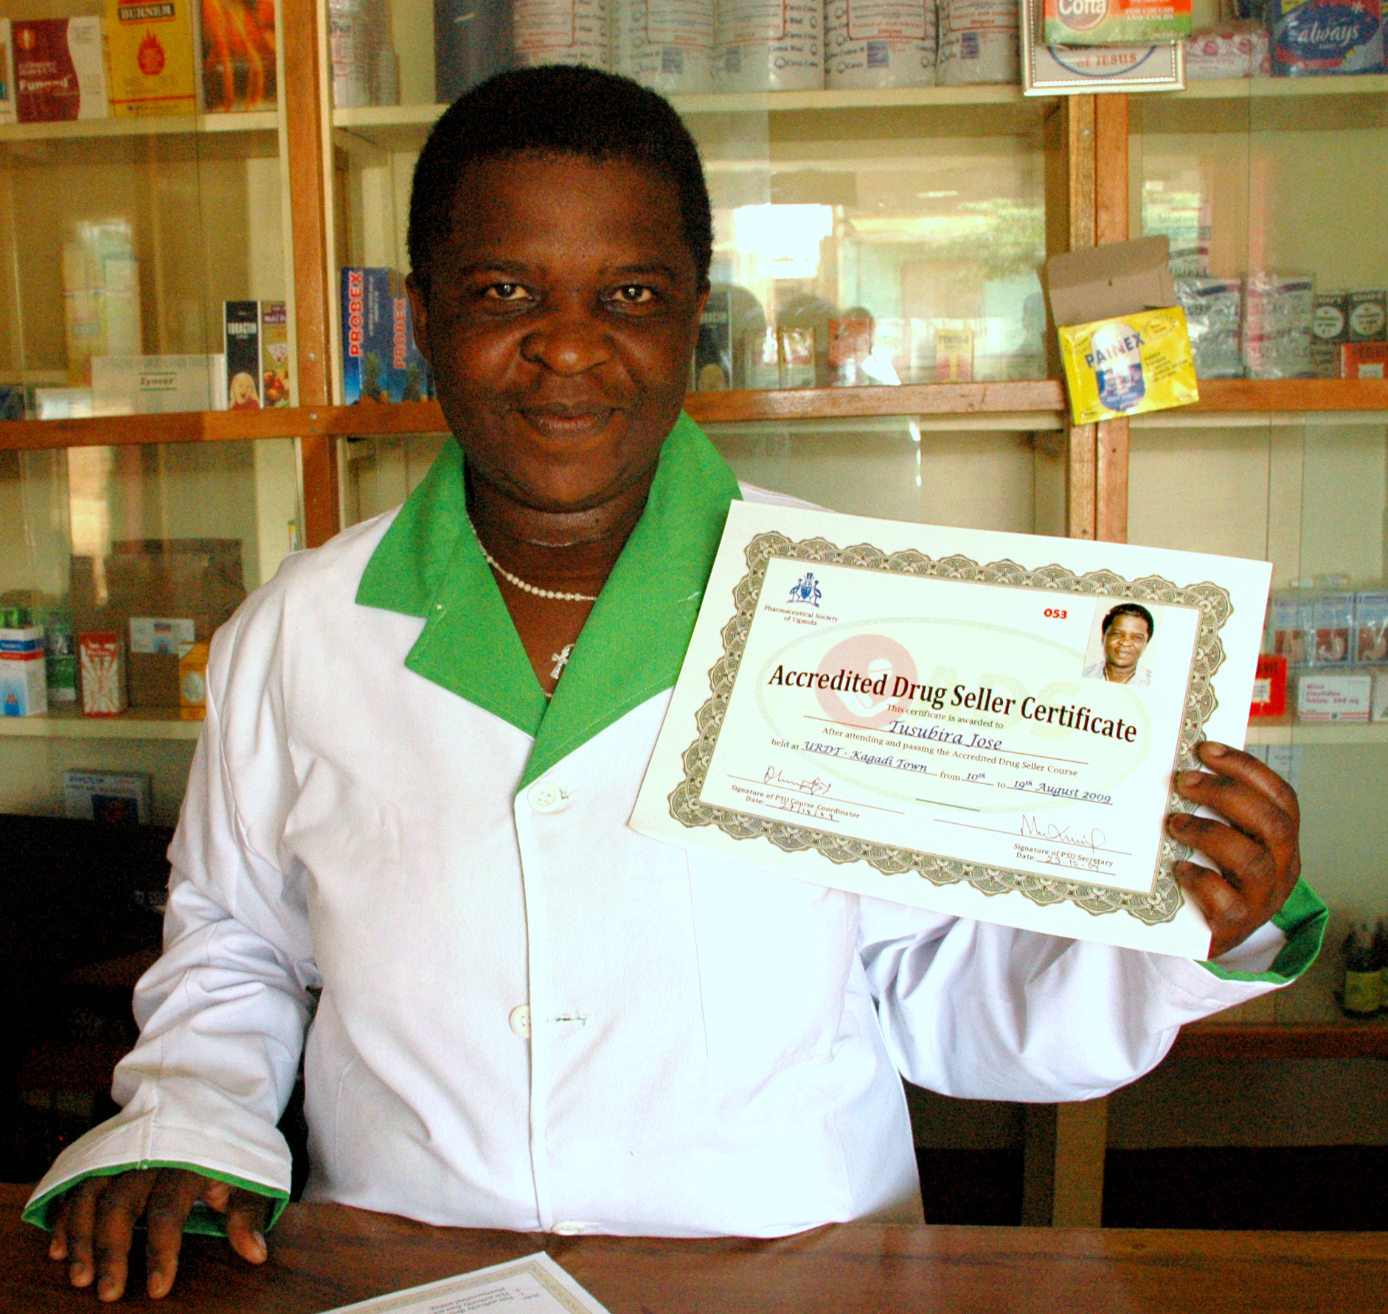
Recommendations
Collaborate with the regulatory authority for retail drug outlets (i.e., medicines regulatory authorities or pharmacy councils)
  Different authorities can oversee premises and products and personnel qualifications
  Regulatory authorities determine the list of products that retail outlets can sell and services they can provide
Work within a holistic framework to facilitate harmonized standards, practices, training
Engage existing owner associations, if they exist
Identify training institutions to take over training in long term
Mobilize resources based on shared interests, but work toward the holistic framework

