Slide 1


Engaging Private Sector Retail Drug Outlets to Improve Access to Essential Medicines in Rural Tanzania:
Experience from the Accredited Drug Dispensing Outlets (ADDO) Program
Eliphace Mkumbo
Principal Technical Advisor-MSH

Slide 2
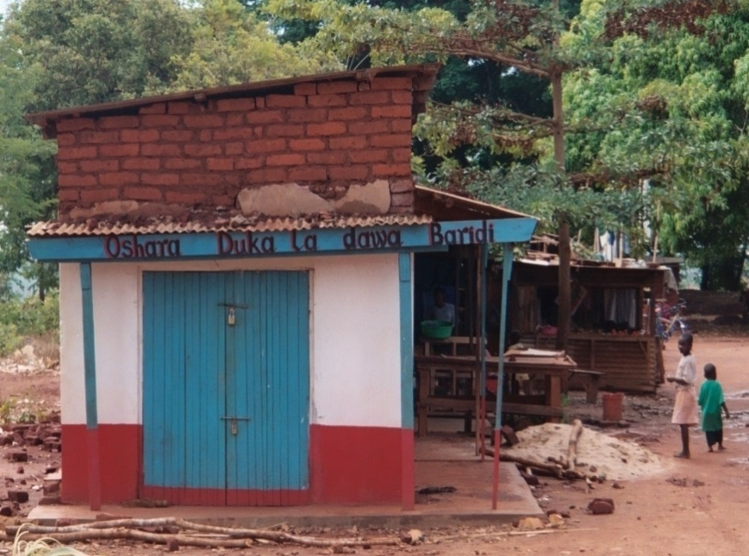
Background
  Results of the MOH/ MSH 2001 assessment in Part II medicine shops:
  Untrained staff
  Poor medicine quality
  Inadequate supervision
  Illegal dispensing of medicines
  Improper storage of medicines
  As a result: Collaboration between MSH and the Ministry of Health and Social Welfare through the then Pharmacy Board with support from the Bill & Melinda Gates Foundation to develop the ADDO program to address these challenges

Slide 3
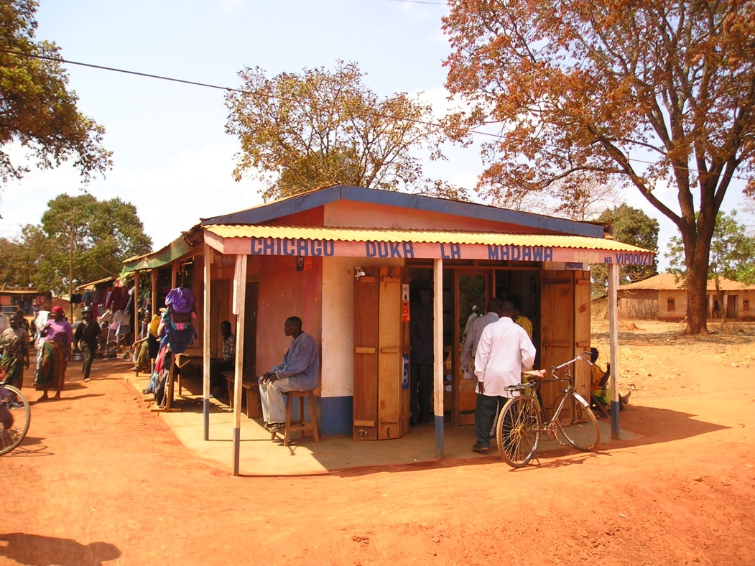
Opportunity for improved access
Drug shops are source of about half of medicine purchases
Over 9,000 drug shops compared to nearly 1,100 registered pharmacies in Tanzania (2015)
Close proximity—95% of population within 5 km of a drug shop
Perception of being more personal; flexible payment methods
Public health facilities often farther away; essential medicines often out-of-stock

Slide 4
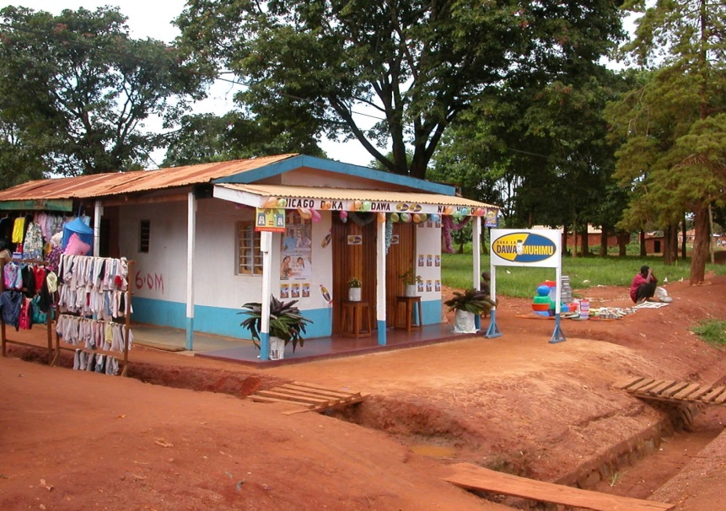
Start-up phase
Transformation of existing Part II medicine shops (duka la dawa baridi) into government-accredited ADDOs through:
  Standard setting
  Training in business/dispensing
  Supportive supervision
  Business incentives
  Regulatory enforcement
Piloting in one region (Ruvuma) in 2003–2004
Successful pilot proved that regulatory and accreditation interventions can improve access to quality medicines and services

Slide 5

ADDO program from concept to scale-up
2001-2003 Assessment and program design
2004 Evaluate pilot
2006-2008 Centralized scale-up
2003-2004
Pilot program in Ruvuma region
2008-2013 De-centralized scale-up
2013-
Program maintenance and sustainability

Slide 6
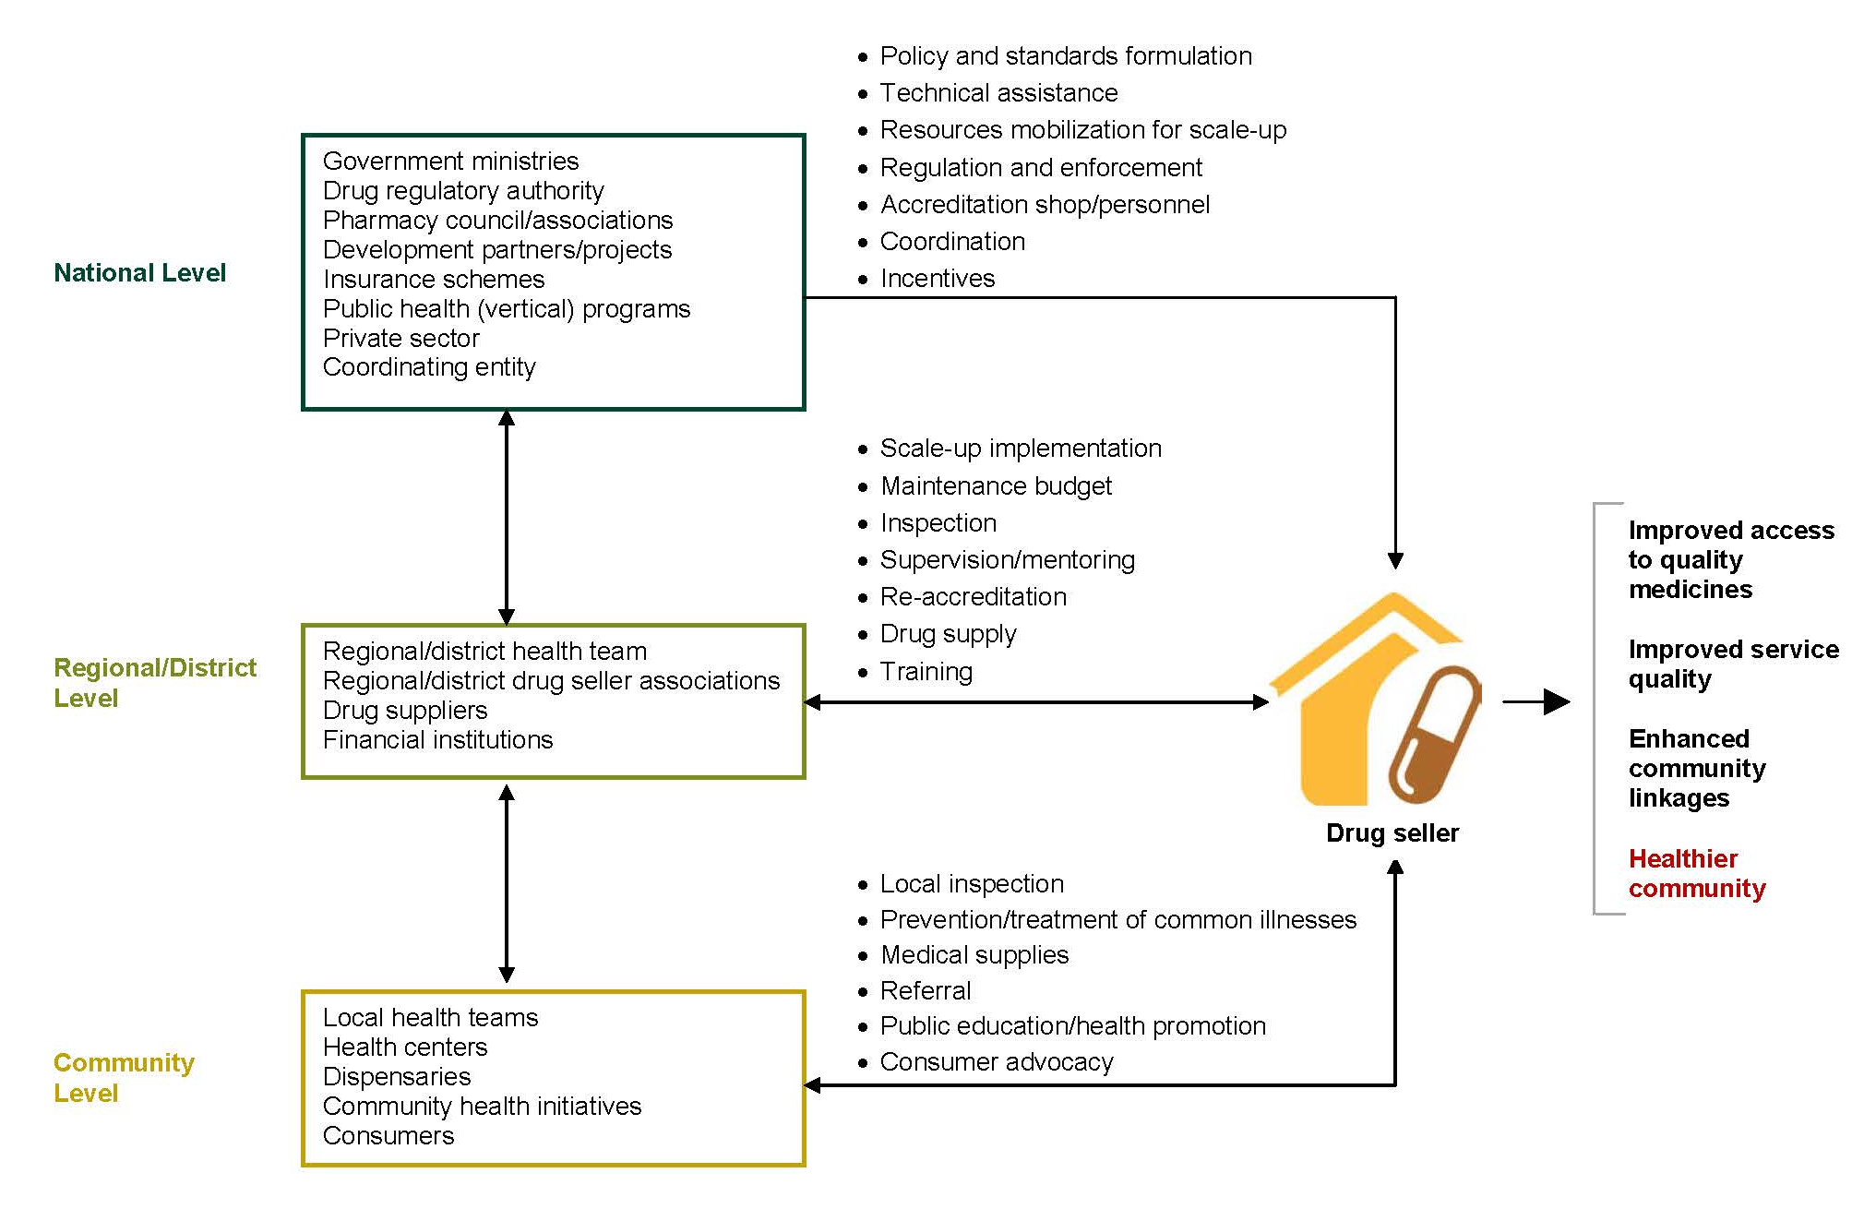
ADDO conceptual framework

Slide 7
Systems-strengthening strategy (1)
Bring drug sellers into health care system through accreditation and regulation
Gain broad-based support from all stakeholders
  National and local authorities, professional and commercial associations
  Participatory approach to design and implementation
Develop requirements and build governance capacity
  Create accreditation standards
  Decentralized local strategy for inspections; central oversight
Build capacity of owners and dispensers
  Business skills
  Dispensing and communication skills

Slide 8
Systems-strengthening strategy (2)
Provide incentives
  Ability to sell selected prescription-only medicines (e.g., antimicrobials)
  Small business loans
Ensure availability and quality of products dispensed
  Products in stock approved by national drug authorities
  More convenient sources of supplies (regional; district)
  Pooled and central purchasing
Ensure quality of pharmaceutical services
  Record keeping
  Knowledge of products and disease conditions
  Monitoring, mentoring, and supervision
Increase consumer demand for quality products and services
  Marketing and branding
  Information and education

Slide 9
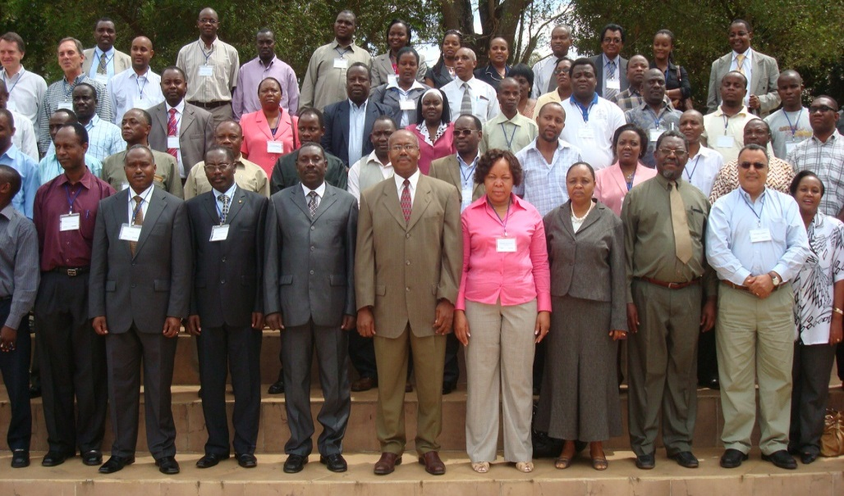
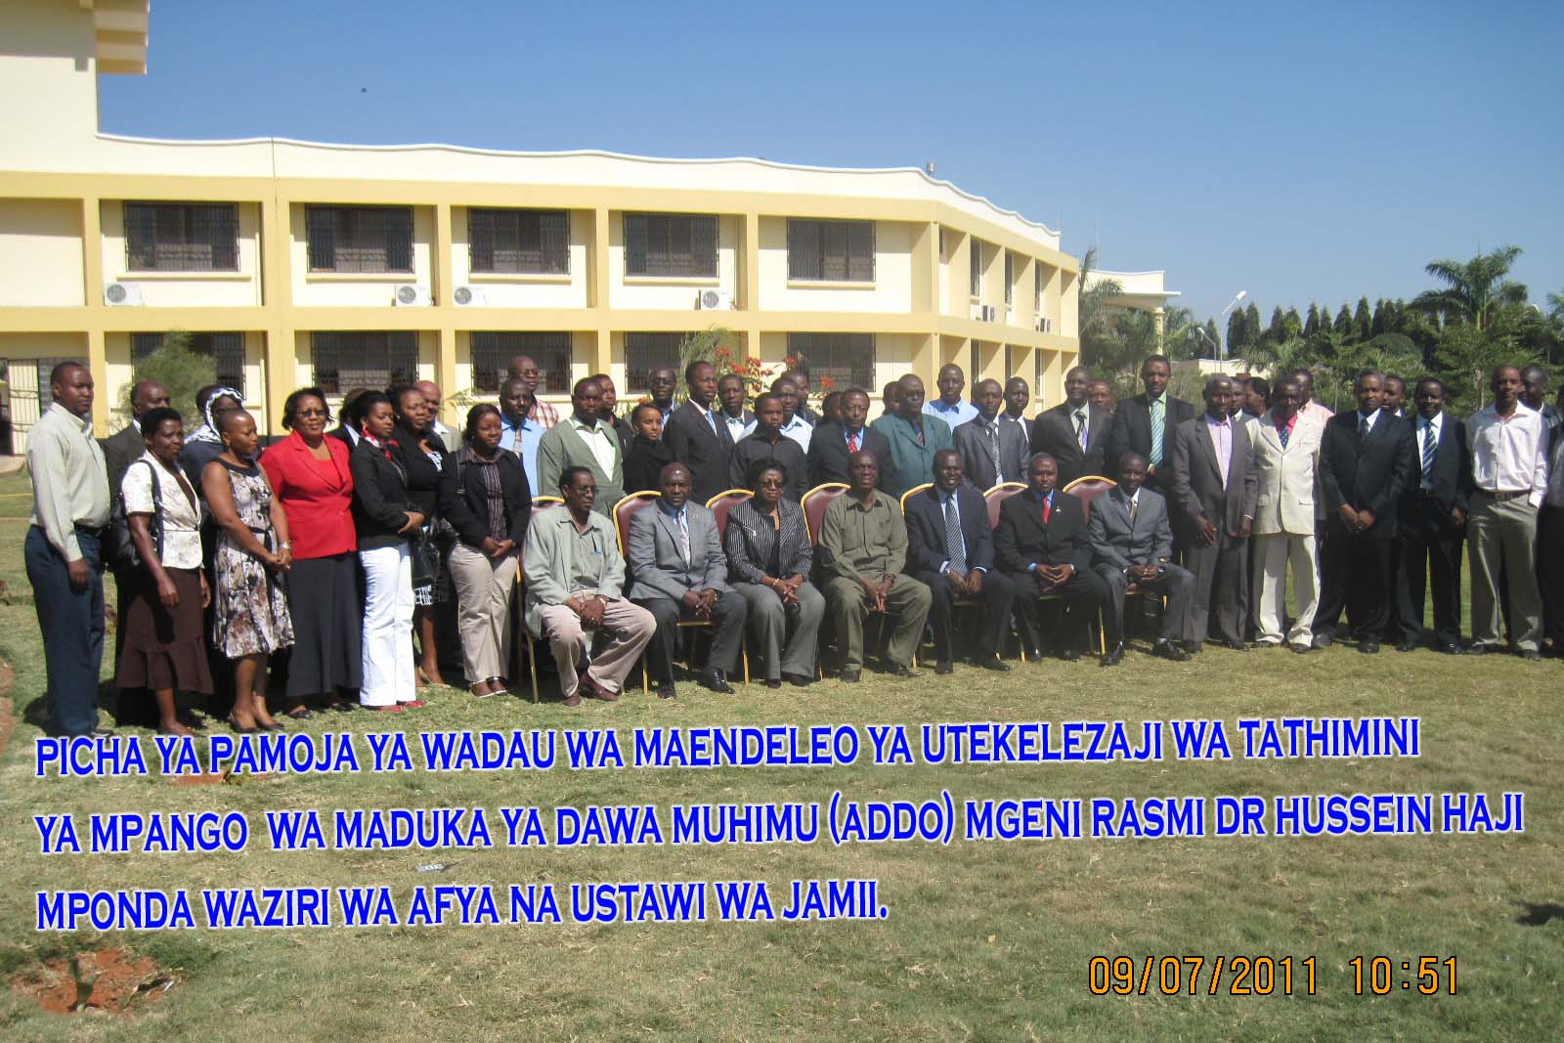
Stakeholder engagement: the linchpin of success and sustainability

Slide 10


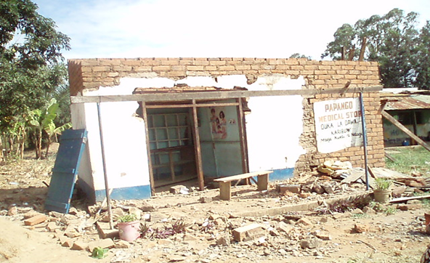
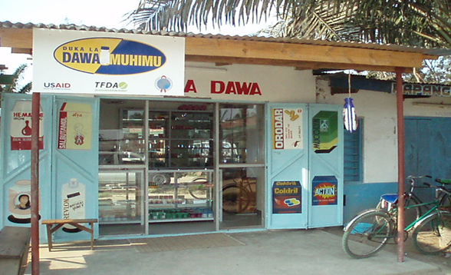

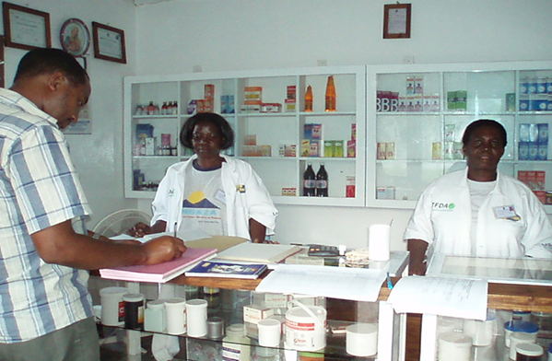
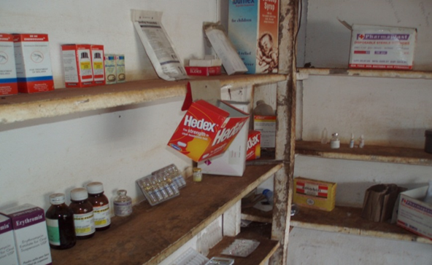
Meeting premises standards

Slide 11
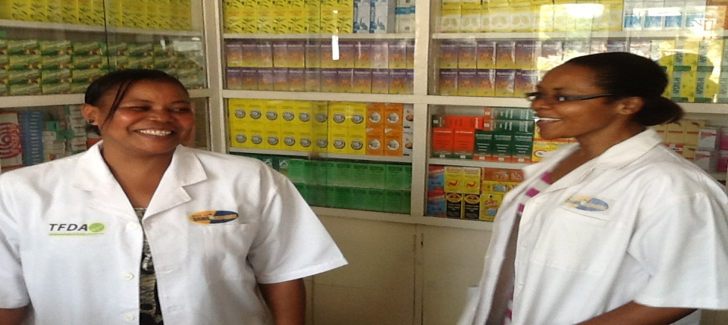

Capacity building for dispensers
Laws, regulations, and code of ethics
Good dispensing practices and rational medicines use
Common medical conditions in the community
Maternal and child health (IMCI); nutrition
Reproductive health/family planning
HIV/AIDS; TB case detection
Chronic care
Reportable conditions (e.g., cholera)
Communication skills and counseling; reporting
Notes:
Continuous monitoring of availability and quality of products through supervisory visits, research, mystery shopping and in future - mobile reporting

Slide 12
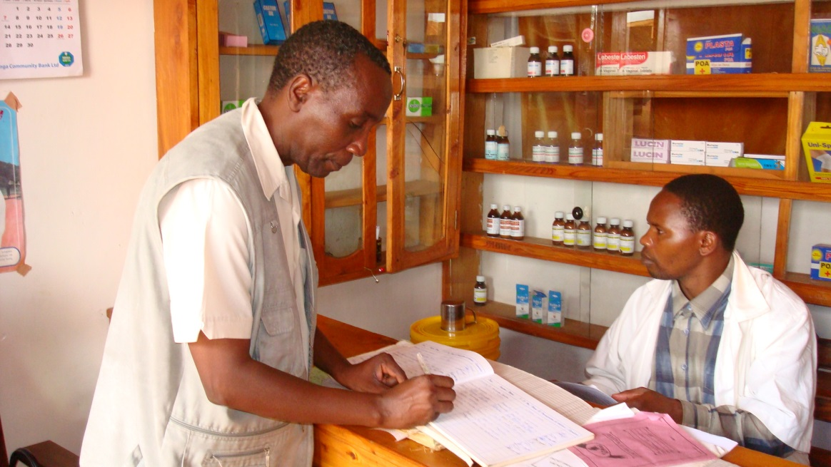
Capacity building for owners and inspectors
Owners
Regulations and standards governing ADDOs
Business skills and entrepreneurship
Inspectors
Training on regulations and standards
Inspection procedures and reporting

Slide 13
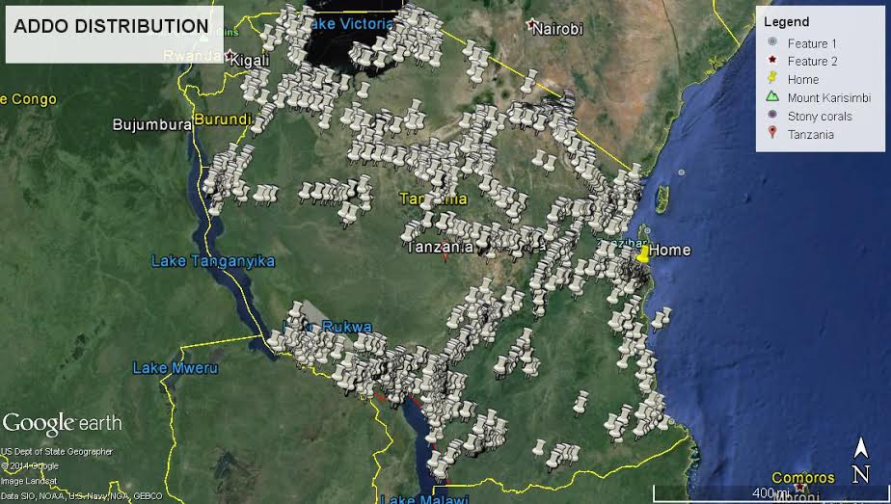
SUCCESS: Country-wide scale up of ADDOs

Slide 14
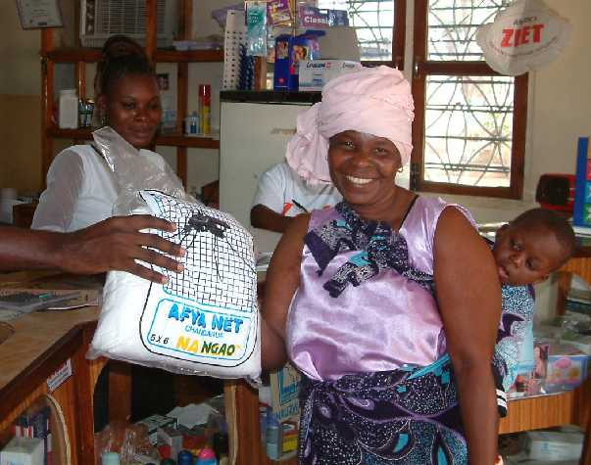
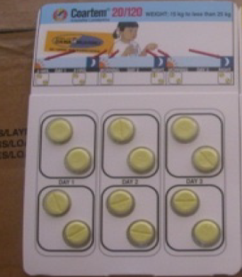




Services to members of National Health Insurance Fund
Child health/IMCI/ improve access to amoxicillin & zinc/ORS co-pack
Source of family planning products
HIV/AIDS information dissemin-ation
Early TB case detection and referral
Access to ACTs and insecticide-treated nets
SUCCESS: Integrated platform for community-based health interventions
Recognition of ADDOs as an ideal platform to offer a wide range of public health interventions at the community level

Slide 15
SUCCESS: Training institutionalization
Seven (7) in-country (zonal level) health training institutions provide courses for ADDO dispensers and owners under supervision of the Pharmacy Council
Standardized training modalities
Owners/dispensers fully meeting training costs
Has led to more dispensers available to meet demand

Slide 16

SUCCESS: ADDO model spread to other African countries
Countries that have adapted the ADDO model
  Uganda
  Liberia
  Zambia
Other interested countries
  Nigeria
  DRC Congo
  South Sudan
  Burundi

Slide 17

Challenges
Devoting time and resources to scale up nationwide
Maintaining regular inspection and supervision activities
Ensuring compliance with accreditation standards
Maintaining reliable record keeping for monitoring and evaluation

Slide 18
Ensuring ADDO program maintenance and sustainability
Goal: Ensure ADDO program maintenance and sustainability
Strengthen the ADDO regulatory system
Integrate the use of mobile technology & GIS
Institutionalize ADDO dispensers training
Establish ADDO associations and expand their roles
Link with community health initiatives
Consumer engagement, marketing, and branding

Slide 19

Thank You for Your Attention

