Slide 1
Expanding Access to Diagnosis and Treatment of Childhood Pneumonia, Diarrhoea and Malaria in the Private Health Sector in Uganda
NDA ADS Stakeholder Meeting
September 22nd 2016

Slide 2
Program background, goals and objectives
In Uganda, the combination of diarrhea, malaria and pneumonia account for almost 30% of U5 deaths
Uganda currently has a child mortality of 55 deaths per 1,000 live births
65% of Ugandans seek 1st line treatment for these diseases in the private sector
Program Goal
To reduce child mortality by increasing the percentage of children properly diagnosed and treated for pneumonia, malaria and diarrhea in the private sector
Program Objectives
Improve frontline private providers’ ability to assess, treat, and refer childhood illnesses
Ensure that lower-level private health facilities are adequately supplied with essential medicines and diagnostics
Improve regulatory and financing environment

Slide 3
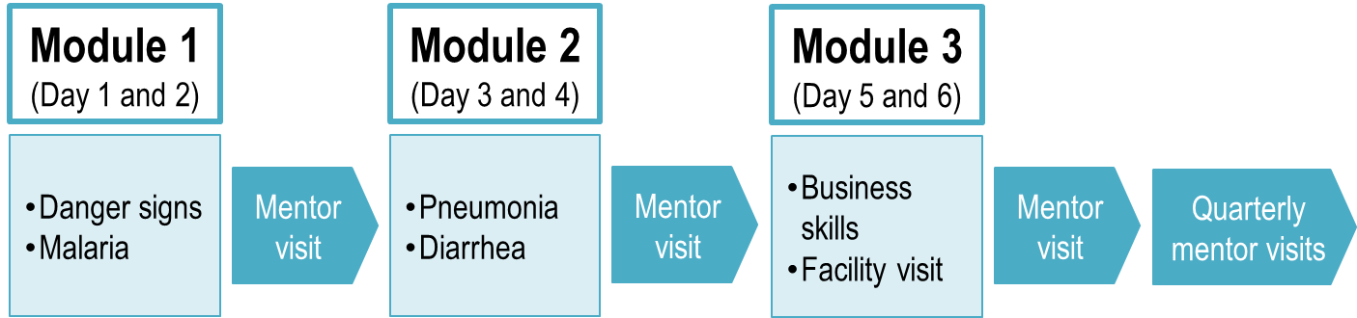
Objective 1: Improve frontline private providers’ ability to assess, treat, and refer childhood illnesses
1,500 drug shops and small clinics from 7 districts scheduled to be trained by the end of 2016
Drug shops receive a modular training based on iCCM (Integrated Community Case management) but adapted for the private sector. Trainings cover assessment, diagnosis, treatment and referral of diarrhea, malaria, and pneumonia as well as business skills and regulatory matters
Along with trainings the program also offers supportive supervision in the form of a mentorship program
Drug shops receive one mentor visit after each training module and continue to receive mentor visits over the next year. Mobile text messages are used to further reinforce key messages.
FIGURE 3. Adapted iCCM Model and Costs
Average cost of training package and mentorship for 1 year:
$200 per person

Slide 4
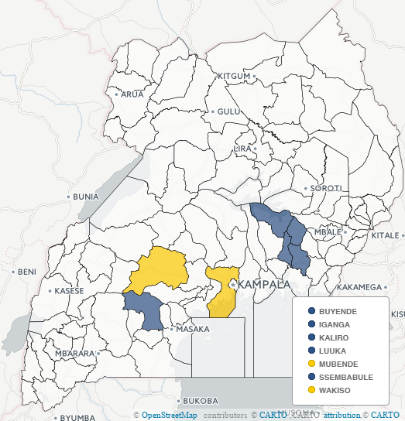
Roll out of training and supervision in the 7 districts has been conducted in a phased manner
7 districts selected for year 1
High level roll out plan
  Apr
  May
  Jun
  Jul
  Aug
  Sep
  Oct
  Nov
  Iganga
  LuuKa
  Kaliro
  Buyende
  Sembabule
  Wakiso
  Mubende
Phase 1 –trainings and mentorships for the first five districts (Iganga, Luuka, Kaliro, Buyende, Sembalbule,)
Phase 2 –Trainings and mentoships for the next two districts (Wakiso and Mubende)

Slide 5
Objective 2: Ensure that lower-level private health facilities are adequately supplied with essential medicines and diagnostics
FIGURE 4. Approach, Stakeholders, & Roles
CHAI activities
Supply chain
Stakeholder engagement
CHAI is also expanding its partnerships with first-line distributors and regional wholesalers to link drug shops with high-quality and affordable essential commodities—including ORS/zinc, ACTs, mRDTs, amoxicillin.
Price subsidies and other major market interferences are continuously avoided to ensure market sustainability.
Sourcing optimization
Marketing support
Supplier forums
Regulatory assistance
Distribution and promotion agreements
Manufacturers and importers
MoH
1st Line Distributors
NDA
Wholesaler-based activation
Sales optimization
Voucher agreements
Linkage to low cost supply
Kampala-based wholesalers
Upcountry wholesalers
Training and mentorship to ~1,500 private frontline providers
Linkage to low cost supply
DHOs
Drug seller associations
Retail pharmacies
Private clinics
Drugshops
Other active NGOs
3rd party facilitator
Supportive supervision

Slide 6


Objective 3: Improve regulatory and financing environment
Supporting the MoH to implement the Recommended Retail Prices (RRP) for ACTs and ORS/zinc, in order to ensure affordability of treatment for caregivers
Supporting MoH and NDA to develop a policy allowing OTC sales of malaria RDTs and re-scheduling of diagnostics (mRDTs) to over-the-counter status to allow access in private sector drug shops and clinics
Supporting MOH and first line distributors to NDA to fast-track registrations of additional brands of essential medicines such as Amoxicillin 250mg dispersible tablets (DT)

Slide 7
Lessons learned so far
Modular training with repeated supportive supervision enhances knowledge levels, clinical behavior, and stock levels.
Curriculum design and modular training seem to be engaging and convenient for participants .
Working with DHO staff increases program sustainability.
Partnering with regional wholesalers to link drug shops and clinics to low cost supply has contributed to increased stock levels.
National supply of key commodities such as Amoxicillin DT, mRDTs, sharps containers and low cost gloves must be improved in order to sustain change over time and at scale.
Managing the logistics of training across multiple sites requires extensive oversight and monitoring to ensure adherence and quality.
Involving the public sector in trainings is critical for strengthening relationships and encouraging referrals.
Control over price levels is limited in a free market and could be increased by demand generating activities such as behaviour change communication (BCC) on pricing structures.

Slide 8
Thank You

Slide 9
Annex

Slide 10
Implementation Progress April - August
Training | Mentorship | Supply Chain
651 drug shops in 5 districts have attended all six trainings days. Wave 2 of trainings targeting 1,000 additional shops commenced in August 2016. 14% total attrition between Module 1 and Module 3. Representatives from public facilities attended trainings and practice sessions at health facilities were successfully conducted | A total of 2,100 mentorship visits conducted between Visits 1 and 3, reaching 93% of trainees at least twice. DHO staff successfully involved in supportive supervision in all districts as well as working directly as mentors in four districts. Real time monitoring made possible by the use of electronic tablets | Price agreements established with 10 regional wholesalers, linking drug shops to affordable medicines. A one-time voucher discount introduced to incentivize drug shops to stock up on all iCCM commodities High quality affordable mRDTs introduced in the private market First Amox 250mg DT registered in Uganda

Slide 11
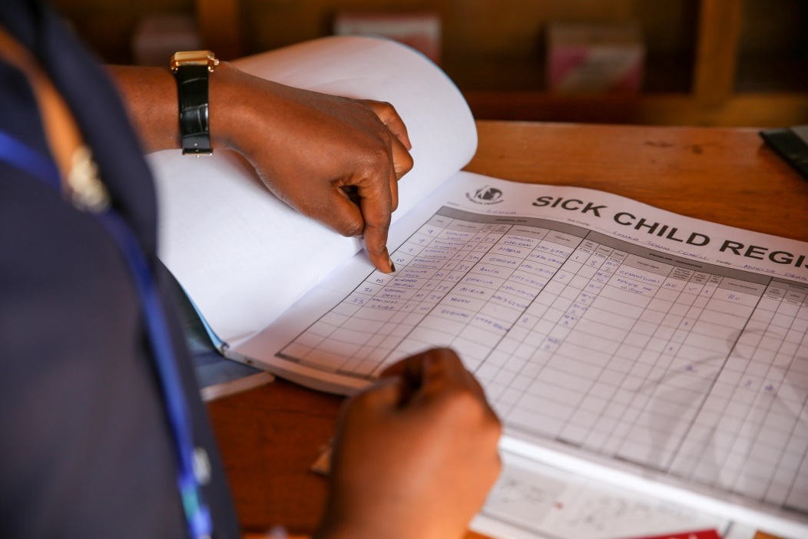
Preliminary data: Program Reach
Data collected from patient registers showed that 19,176 children under 5 were assessed and registered over the time between the first training and the last mentor visit for Wave 1.
Fever was the most common symptom (79% of children), followed by cough and diarrhea. 47% of children presented multiple symptoms.
13% of all children seen presented one or more danger signs, and 13% were referred to another facility.

Slide 12
Preliminary data: Stock levels
Increased uptake of key commodities – the number of shops stocking the iCCM commodities increased significantly between Visits 1 and Visit 3
Stock levels also increased for almost all commodities
Median price levels at the third mentor visit show progress towards program targets

Slide 13
Preliminary data: Diagnosis and Treatment
  mRDT testing in cases of fever increased from 77.9% to 84.6% between visit 1 and visit 3 and adherence to test results also improved.
  % of children with diarrhea given both ORS and Zinc increased from 56% at the first mentor visit to 82% at the third visit. Prescription of ORS and zinc only decreased overtime as diarrhea treatment.
  47% of children with cough had their breathing rate counted at the third mentor visit.
  96% of children were given Amox for cough and fast breathing at the third mentor visit while only 7% of children without cough and fast breathing received Amoxicillin.

