Slide 1
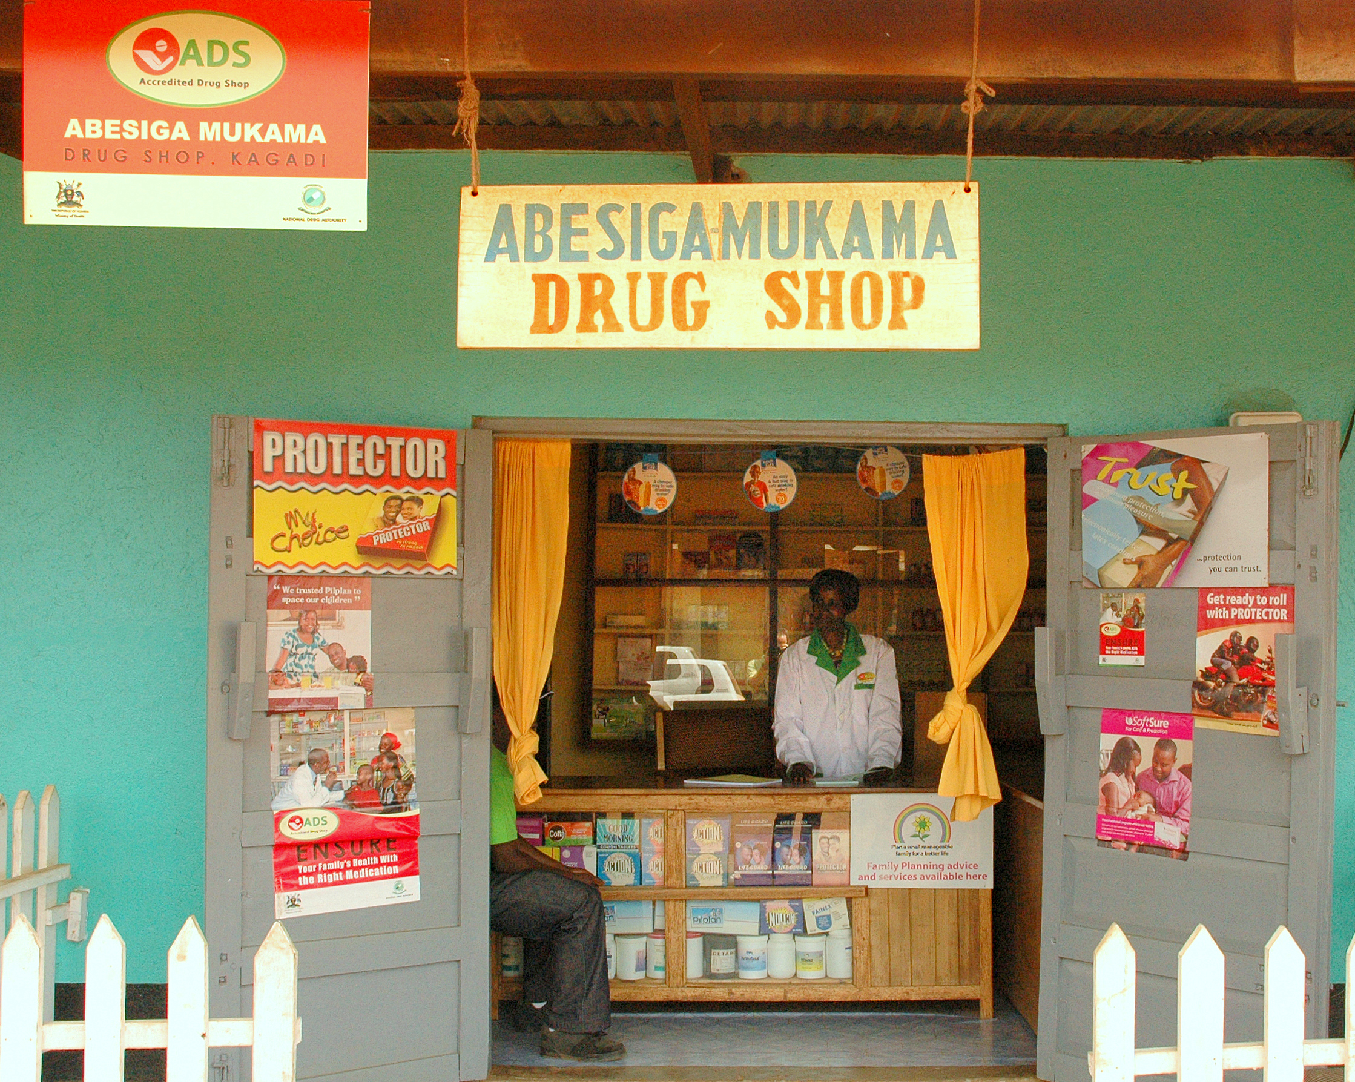
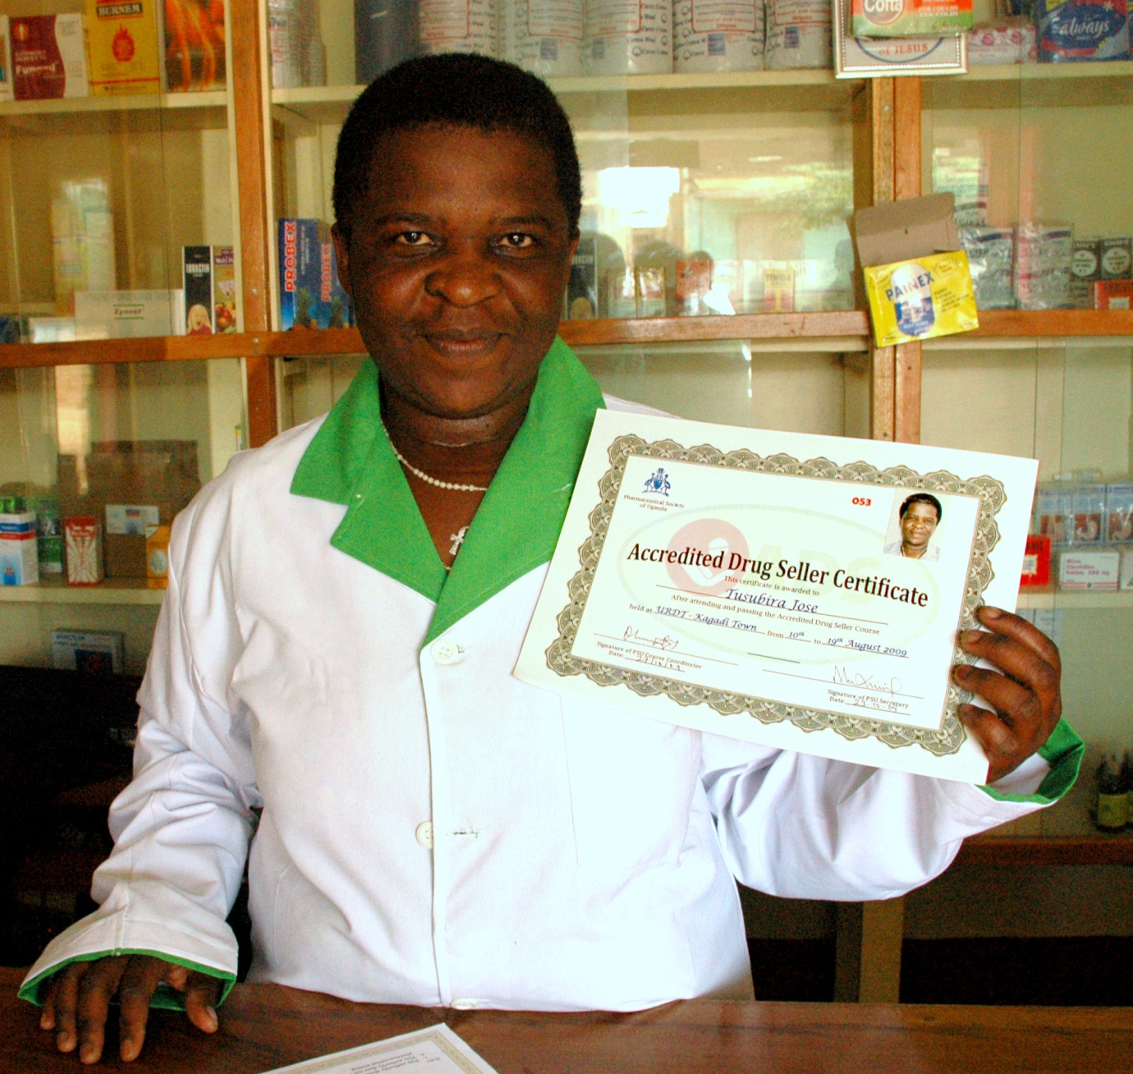
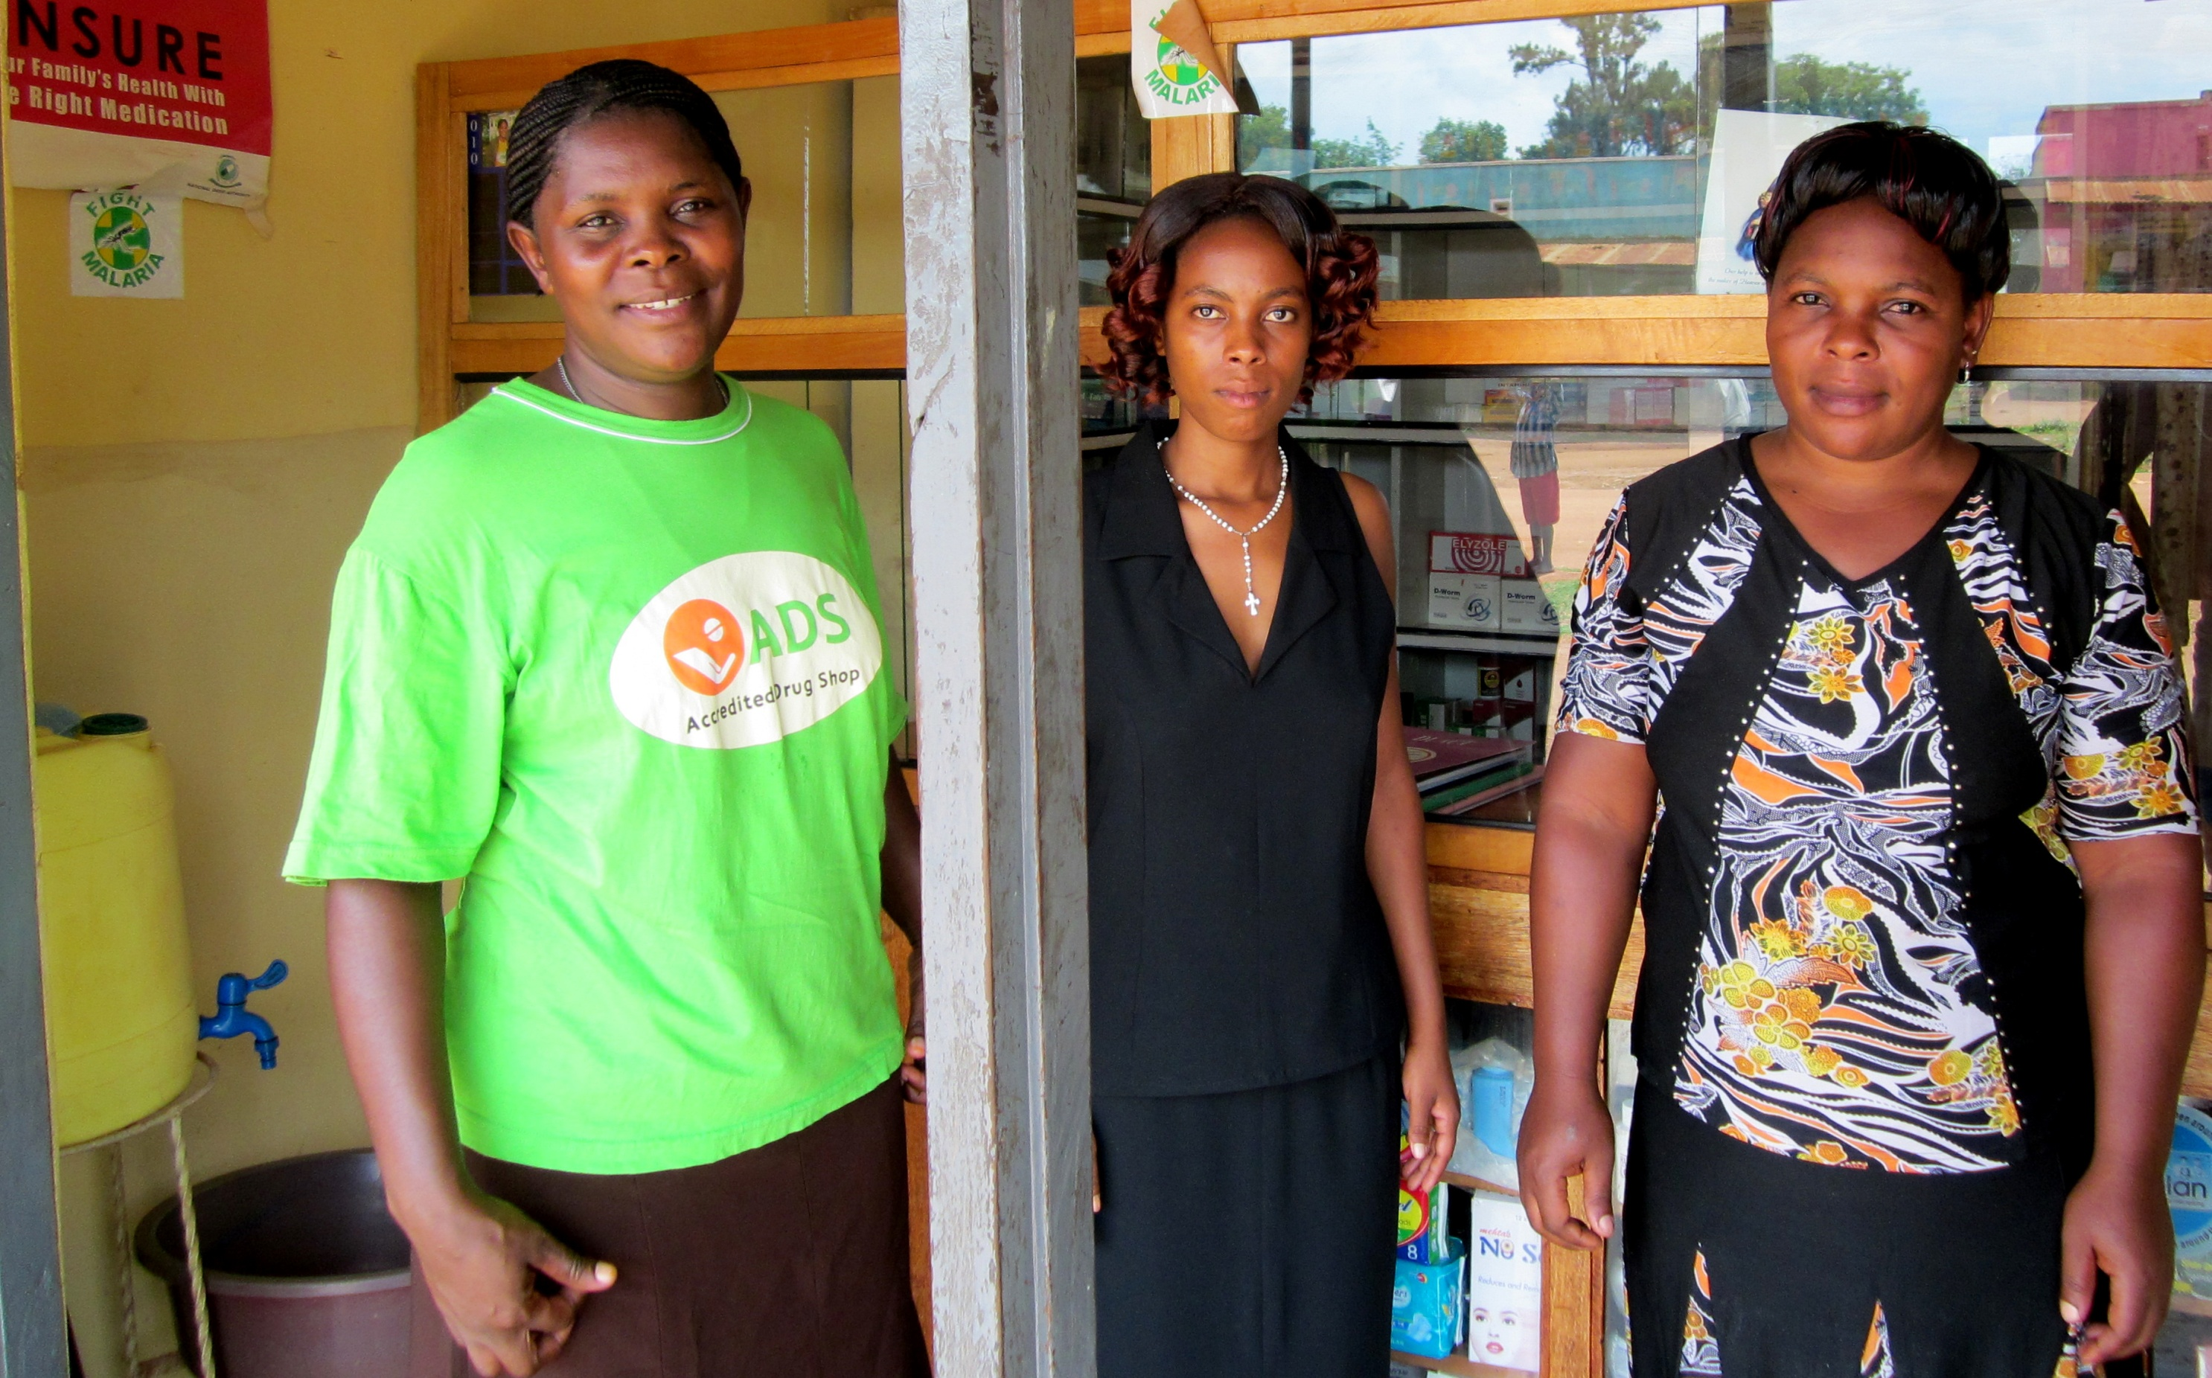

Providing quality family planning products and services through Accredited Drug Shops in Uganda
Aziz Maija, MSH Uganda , Nasser Lubowa, Uganda National Drug Authority, and Eliphace Mkumbo, LaunchDSI Tanzania. Contact: LaunchDSI@MSH.org
Background
Uganda’s NDA collaborated with MSH to conceptualize and implement an accredited drug seller initiative which transformed existing Class C drug shops into regulated, profitable Accredited Drug Shops (ADS)
ADS were piloted in Kibaale district (2009–2011); legal availability of antibiotics increased from 57% to 84% and illegal availability of injectables dropped from 61% to 0
MSH’s STRIDES program broadened the family planning services that ADS provide and expanded ADS to the Kyenjojo, Kamwenge, Kamuli, and Mityana districts
Approach/Methods
NDA Scale-up Strategy
NDA is scaling up ADS and has expanded to Isingiro, Kiruhura, Kyenjojo, and Rukungiri districts.
Incorporate family planning into the ADS training curriculum
Train drug sellers to counsel women on family planning, initiate oral contraceptives or condoms, and refer to nearby health facilities for other methods
Accredit ADS attendants and premises that meet ADS standards
Conduct supportive supervision of ADS attendants
Provide family planning registers for sellers to maintain
Results/Accomplishments
Because the vast majority of ADS attendants are women who live in the communities they serve, linking ADS shops to the provision of family planning products is a natural fit.
Between June and December 2012, 430 drug sellers were trained and accredited in the four districts
Data collected demonstrated improved access to family planning services from the ADS outlets; for example—
  From July–December 2012 in Kyenjojo, 56 ADS served 2,623 family planning clients: 52% received oral contraceptives while 13% were referred to public health facilities for other methods of family planning
  In Kamwenge from September 2012–March 2013, 1,012 new clients and 696 returning clients accessed family planning services from 40 ADS outlets; 1,050 cycles of oral contraceptives were dispensed
  From October 2012–May 2013 in Kamuli, 88 ADS served 4,942 family planning clients; 2,664 cycles of oral contraceptives were dispensed; 470 clients were referred to public health facilities for other methods of family planning
  From September 2012–April 2013 in Mityana, 97 ADS served 2,811 family planning clients; 2,842 cycles of oral contraceptives were dispensed; 340 clients were referred to public health facilities for other methods of family planning
Facilitating Accredited Drug Seller Initiative Expansion
MSH has received a grant from the Gates Foundation to facilitate expansion of accredited drug seller initiatives in Africa (LaunchDSI)
LaunchDSI will use three mechanisms to assist interested countries:
Information and guidance: Determine feasibility of adapting the accredited drug seller model
Technical assistance: Develop capacity to carry out implementation of an initiative
Small start-up grants: Help a limited number of countries move forward with planning
LaunchDSI has created a resource center located within the MSH Tanzania office
Expressions of interest are now being solicited

